Slide 1

LOGISTIC REGRESSION

Slide 2
Logistic Regression:
Logistic regression is one of the most popular Machine Learning algorithms, which comes under the Supervised Learning technique.
Logistic regression is a classification algorithm. It is used to predict a binary outcome based on a set of independent variables.
The nature of dependent variable is dichotomous/categorical, which means there would be only two possible classes.
In simple words, the dependent variable is binary in nature having data coded as either 1 (stands for success/yes) or 0 (stands for failure/no).

Slide 3
Logistic Regression is much similar to the Linear Regression except that how they are used. Linear Regression is used for solving Regression problems, whereas Logistic regression is used for solving the classification problems.
It is one of the simplest ML algorithms that can be used for various classification problems such as spam detection, Diabetes prediction, cancer detection etc.
The dependent variable must be categorical in nature.
The independent variable should not have multi-collinearity.

Slide 4
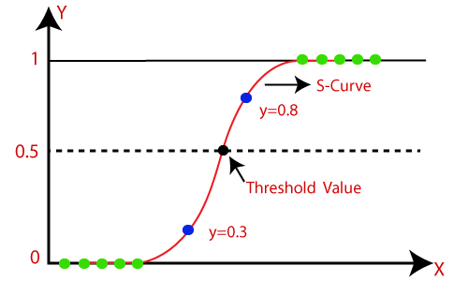
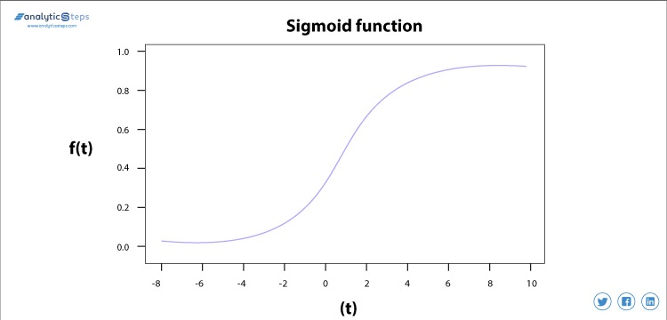

Slide 5
Function use in Logistic Regression:
Logistic function is used in logistic regression i.e. also known as sigmoid function.
It maps any real value into another value within a range of 0 and 1.
The value of the logistic regression must be between 0 and 1, which cannot go beyond this limit, so it forms a curve like the "S" form. The S-form curve is called the Sigmoid function or the logistic function.
Sigmoid Function acts as an activation function in machine learning which is used to decides which value to pass as output and what not to pass

Slide 6
Y = 1 / 1+e ^{-x}
^{X = Independent variable}
e = natural logarithm base(also known as Euler’s number) where e = 2.178
Sigmoid function trying to convert the independent variable into a expression of probability that ranges between 0 to 1 with respect to dependent variable
If the value of x goes to positive infinity then the predicted value of y will become 1 and if it goes to negative infinity then the predicted value of y will become 0.

Slide 7
Types of Logistic Regression:
Generally, logistic regression means binary logistic regression having binary target variables, but there can be two more categories of target variables that can be predicted by it. Based on those number of categories, Logistic regression can be divided into following types
Binary/Binomial
Multinomial
Ordinal

Slide 8
Binary/Binomial:
In such a kind of classification, a dependent variable will have only two possible types either 1 and 0. For example, these variables may represent success or failure, yes or no, win or loss etc

Slide 9
Multinomial:
In such a kind of classification, dependent variable can have 3 or more possible unordered types or the types having no quantitative significance. For example, these variables may represent “Type A” or “Type B” or “Type C”.

Slide 10
Ordinal :
In such a kind of classification, dependent variable can have 3 or more possible ordered types or the types having a quantitative significance
For examples of such variables might be t-shirt size (XS/S/M/L/XL), answers on an opinion poll (Agree/Disagree/Neutral), or scores on a test (Poor/Average/Good).

Slide 11
Application of Logistic Regression
Spam Detection
Spam detection is a binary classification problem where we are given an email and we need to classify whether or not it is spam. If the email is spam, we label it 1; if it is not spam, we label it 0. In order to apply Logistic Regression to the spam detection problem, the following features of the email are extracted:
Sender of the email
Number of types in the email
Occurrence of words/phrases like “offer”, “prize”, “free gift”, etc.
The resulting feature vector is then used to train a Logistic classifier which emits a score in the range 0 to 1. If the score is more than 0.5, we label the email as spam. Otherwise, we don’t label it as spam

Slide 12
Tumor Prediction
A Logistic Regression classifier may be used to identify whether a tumor is malignant or if it is benign. Several medical imaging techniques are used to extract various features of tumors. For instance, the size of the tumors, the affected body area, etc. These features are then fed to a Logistic Regression classifier to identify if the tumor is malignant or if it is benign

Slide 13
Why logistic regression is used to solve classification problems?
Logistic regression maps any real value into another value within a range of 0 and 1 by using sigmoid function.

